Slide 1
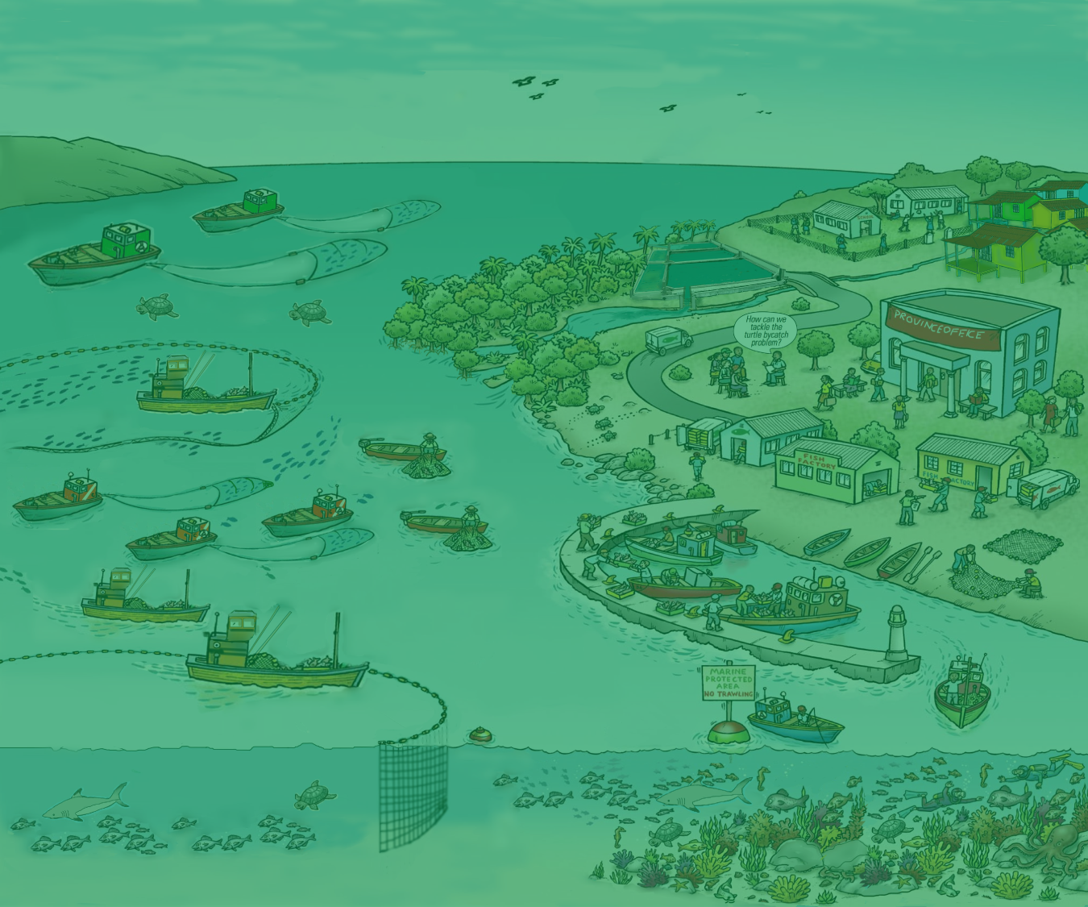
5. Moving towards EAFM
Version 1

Slide 2
Analyze your current fisheries management approaches and practices
Activity: How much EAFM are you already doing?
Identify which EAFM elements you are already doing
Identify the gaps in your EAFM practices and suggest ways to address these
Share these in your groups. Keep notes (you will need these for rest of course)
2
Notes:
The aim is for participants to think individually for 5 minutes about what aspects of EAFM they may already be doing, and where the gaps are. Then share their ideas in smaller groups of 2s or 3s at their tables.

Slide 3
Moving towards EAFM
You are already doing EAFM
It’s an evolving process
Only beginning to address other ecological factors such as habitat impacts, bycatch and protected species interactions (seabirds and sea turtles)
Expands upon conventional fisheries management:
- increasing stakeholder engagement
- broadening scale of management
- increasing data and information needs
3
Notes:
Using the US as an example, we have demonstrated why the conventional approach to fisheries management failed in the case of the lobster fishery in the Northwestern Hawaiian Islands.
The in the broader context of the US, a country that has ample resource, we have demonstrated that given an enabling legislative environment and governance structure, EAFM has been put into action.
That said, from the timeline, one can see that EAFM is an evolving process that takes time. The Coral reef fishery management plan is only beginning to address ecological factors other than the target species, such as habitat impacts, bycatch and protected species.
Moving from the single species fishery management plan to the coral reef ecosystem plan involved:
Broadening scale of management
Increased stakeholder engagement (the public and participatory process of the council system)
The increased data and assessment inputs required (for instance the effect of oceanographic variability on lobster recruitment and the need for annual catch limits for all targeted species)
Wider ecosystem and social considerations lead to increase data and assessment needs.

Slide 4
Moving towards EAFM
Implementing EAFM takes time
EAFM is an iterative process; lessons learned along the way
Many fisheries are doing EAFM in part; moving towards EAFM does not require drastic change but many small steps through time
4
Notes:
Using the US as an example, we have demonstrated why the conventional approach to fisheries management failed in the case of the lobster fishery in the Northwestern Hawaiian Islands.
The in the broader context of the US, a country that has ample resource, we have demonstrated that given an enabling legislative environment and governance structure, EAFM has been put into action.
That said, from the timeline, one can see that EAFM is an evolving process that takes time. The Coral reef fishery management plan is only beginning to address ecological factors other than the target species, such as habitat impacts, bycatch and protected species.
Moving from the single species fishery management plan to the coral reef ecosystem plan involved:
Broadening scale of management
Increased stakeholder engagement (the public and participatory process of the council system)
The increased data and assessment inputs required (for instance the effect of oceanographic variability on lobster recruitment and the need for annual catch limits for all targeted species)
Wider ecosystem and social considerations lead to increase data and assessment needs.

Slide 5
Activity: in groups
Identify the challenges your country might face in moving towards EAFM
Write each challenge on a card. (ONE challenge per card)
Now identify opportunities your country may have in moving towards EAFM (and in meeting the above challenges).
Write each opportunity on a separate card
5
Notes:
1. Participants share initial ideas with neighbour (in pairs)
2. As a group, identify and write 2-3 constraints (challenges) THEIR COUNTRY might face in trying to move towards EAFM (refer to output from activity 1). Write only 1 challenge per card, on e.g. green cards.
3. Get same groups to identify opportunities (write these on different colour cards, e.g. yellow). A challenge in one country may be an existing opportunity in another.
4. Get all groups to walk to back of the room and place constraints and opportunity cards on the floor (on 2 differently-labelled flipcharts).
5. Trainer groups cards (on floor, with all participants helping) and facilitates a brief discussion. Match opportunity cards to challenges cards if possible. Have brief discussion about overcoming challenges- elicit ideas from participants (linking to local/country continuum table produced earlier on flipchart, as well as threats and issues from day 1).
Trainer sorts and keeps outputs for days 3 and 4 (see session plan).
Possible challenges for countries moving to EAFM: lack of funding; lack of government structures; lack of government support; corruption; short term government posts (i.e. reflect short term perspective only); misconception about management structures needed; decentralisation means responsibility is passed on; weakness of fisher associations/ groups; hierarchical social structure (i.e. does not favour stakeholder participation)…

